Slide 1

Group 7: KaraN Malik Vinod Kumar Reddy Subramanian t p
BAN 610 - DBMS PROJECT PRESENTATION

Slide 2
INTRODUCTION Zomato is an e-food platform which provides information on restaurants, bars, clubs and dine-outs. It offers online food delivery and serves customers across many countries. Business goals →Enabling easy access to restaurants at affordable prices from various locations →Efficient technology setup for easy access by customers and other partners →Provides clear content on social media platforms to promote the brand. →Assisting restaurants promote their banners on the site to increase visibility to customers. Products/services →Collaborating with payment applications to bring in discounts and many payment options. →Use of analytical tools to sense customer interest and allowing restaurants to flash offers. →Partners with restaurants and organizes food events. →Hassle free food delivery services with subscriptions for all partners ->Publishes data about ratings to evaluate restaurants and build customer loyalty.

Slide 3
User requirements Zomato has stakeholders playing different roles to offer services. Below are the requirements: 1.Customer is identified with his personal information. Customer ID is the identifier Other attributes : first name, last name, phone number, email ID and address 2. Customer can place any number of orders and order must belong to one customer. Order ID is the identifier → Other attributes : order date, order price and order detail. →Order detail can have more than one food. 3.Customers can reserve tables in restaurants . Restaurant ID is unique identifier. → Other attributes : name, restaurant type(s) and restaurant detail (contact information, menu), feedback (ratings, reviews). →Booked data and time shows that customer has reserved a table using Reservation number →Customer can order from none or many restaurants. Restaurants can serve zero or many customers. 4. Each order will be delivered by an agent to customer. Delivery ID of agent is identifier. →Other attributes : First name, last name and his phone number →Delivery of order is tracked by Delivery time and agent can deliver many orders.

Slide 4
User requirements 5.Queries related to payment orders are answered through customer support.Query ID is the identifier. → Other attributes : Query, customer executive ID, and resolution status. →Customer can have zero or many queries. Resolution date tracks the query completion date. →An executive can respond to multiple customers/queries. 6.Customer can have none, one or many subscriptions. Subscription ID is the identifier of the service offered →Other attributes : Date placed, Validity, Cost and Subscription name →Subscription is unique for a user and user can have one subscription at a time. 7.Customer can have many notifications. →Notification is dependent on the customer interest and behavior →Notification message as an attribute.

Slide 5

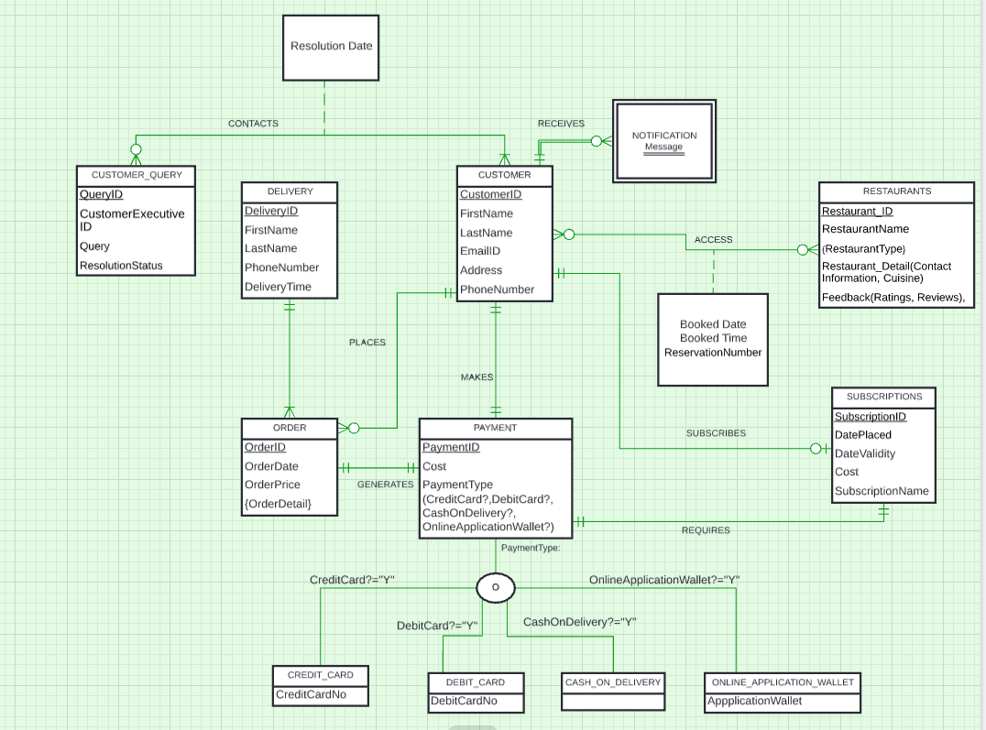

Conceptual Data Modeling

Slide 6
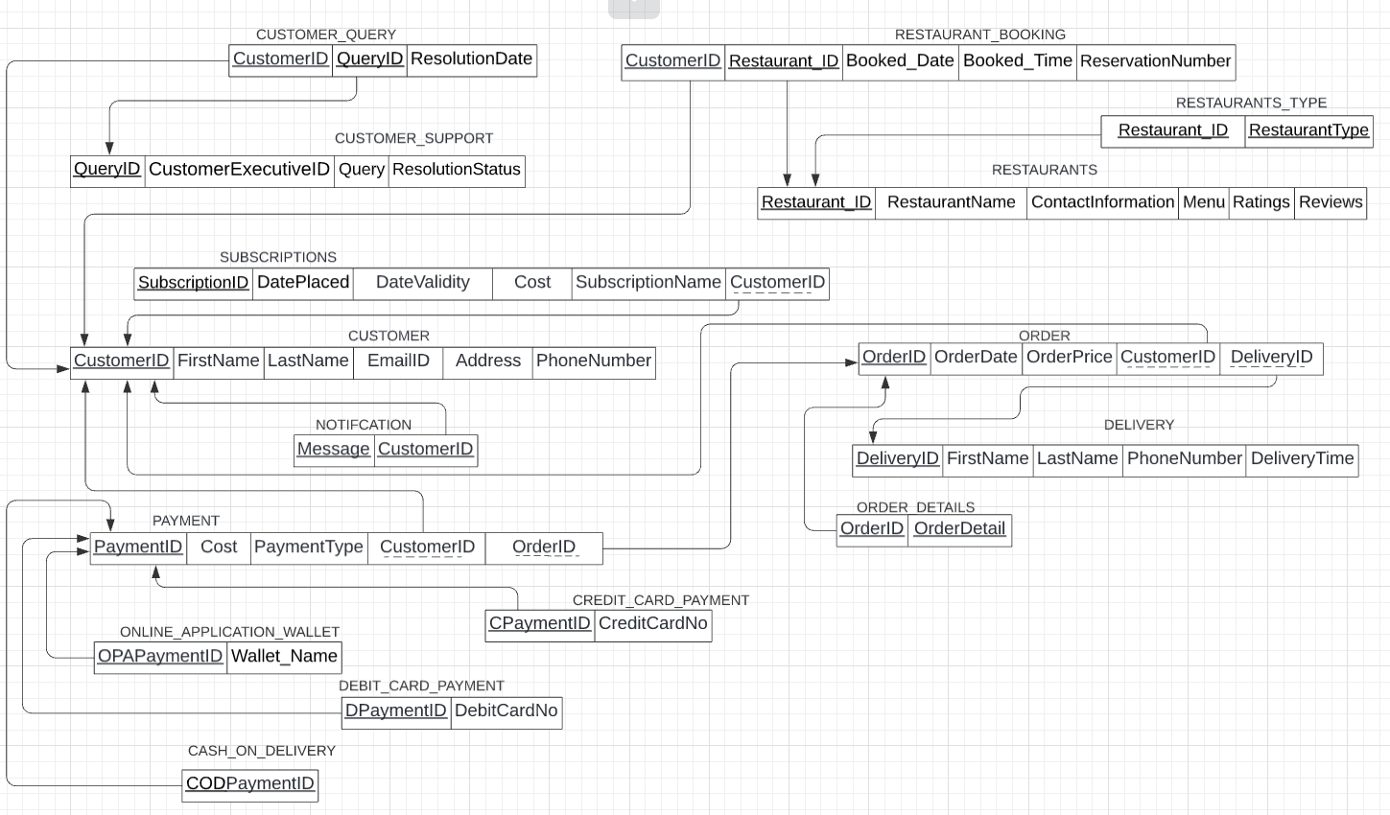
Logical Data MODEL

Slide 7
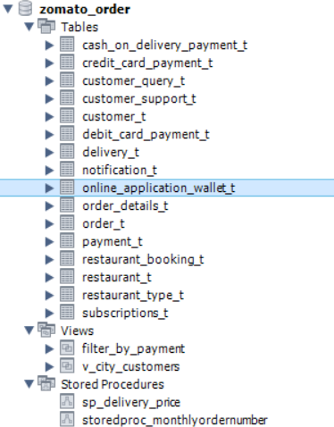
Schema

Slide 8
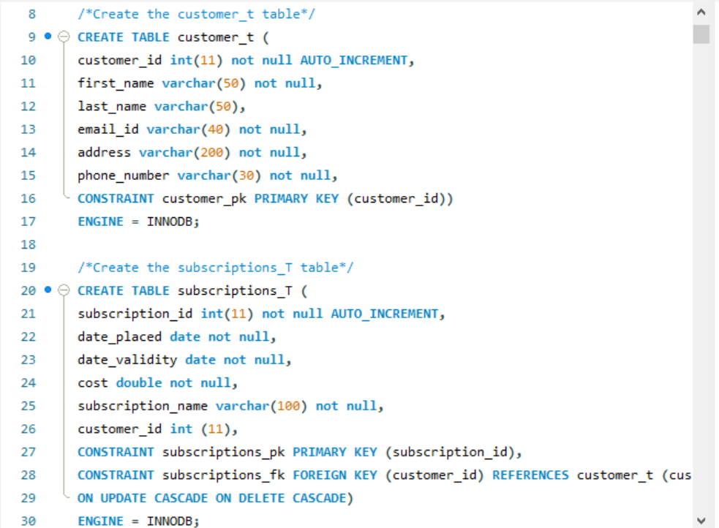
EXAMPLES OF tables – CUSTOMER & SUBSCIPTION

Slide 9
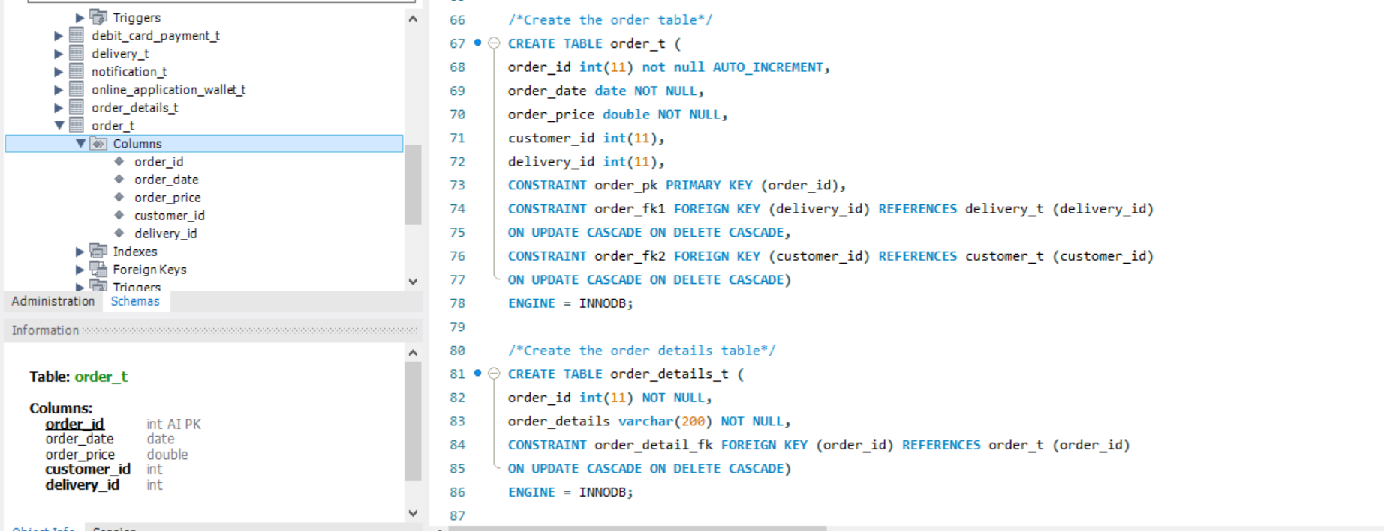
EXAMPLES OF tables – ORDER & ORDER DETAILS

Slide 10
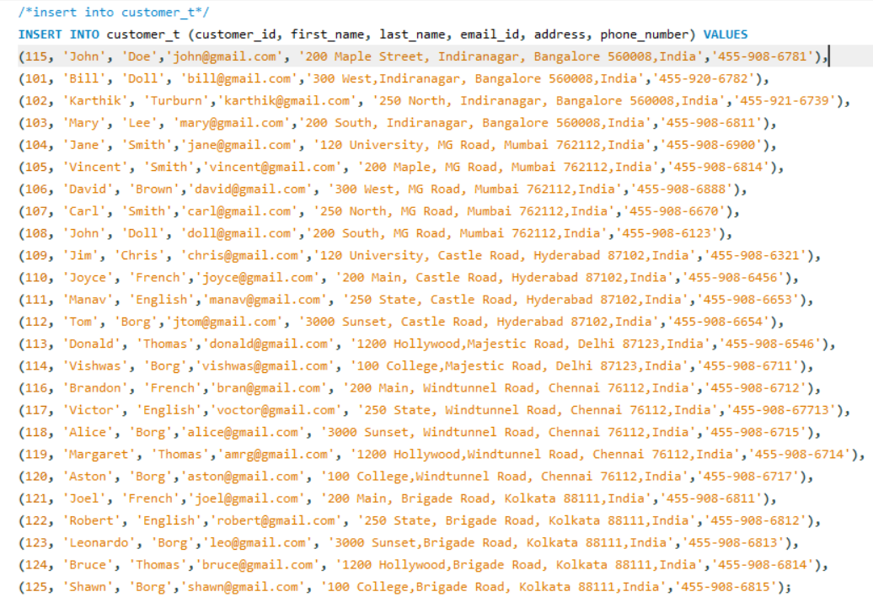
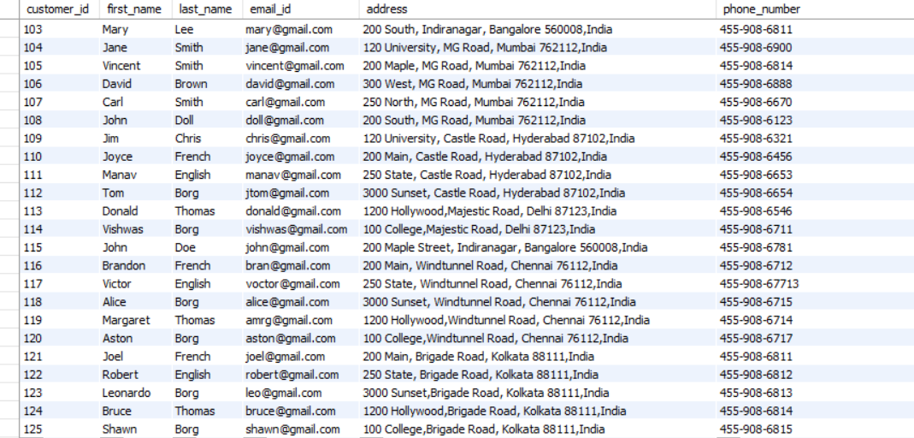
DATA INSERTION

Slide 11
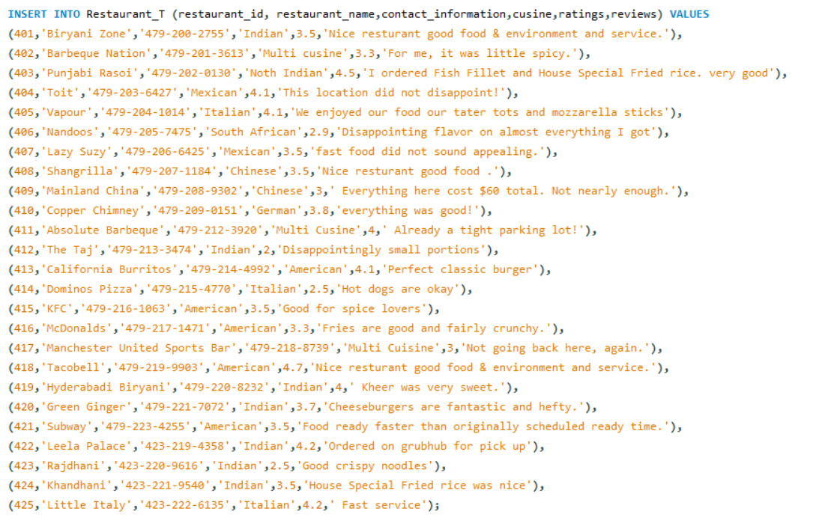
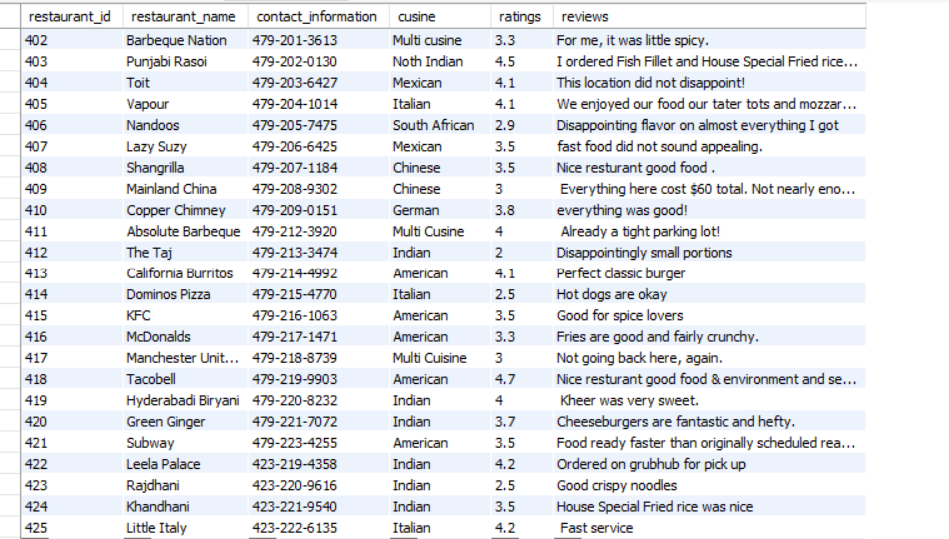
DATA INSERTION

Slide 12
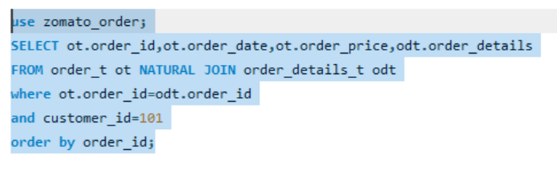
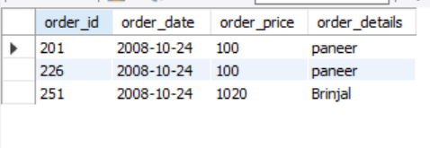
QUERY – 1 (ORDER HISTORY OF A PATICULAR USER) - USING NATURAL JOIN
QUERY
OUTPUT

Slide 13
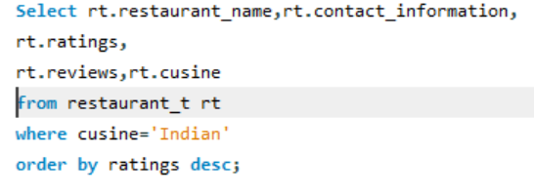
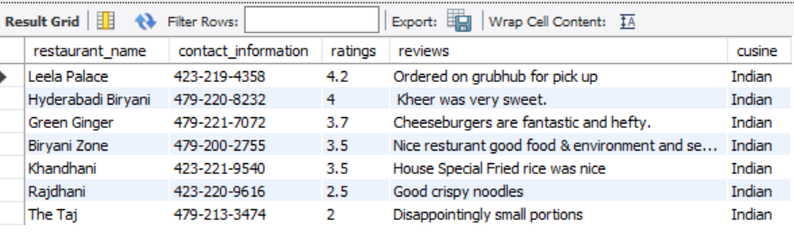
QUERY–2 (RESTAURANT LIST ACCORDING TO CUISINE) - USING ORDER BY & DESC
QUERY
OUTPUT

Slide 14
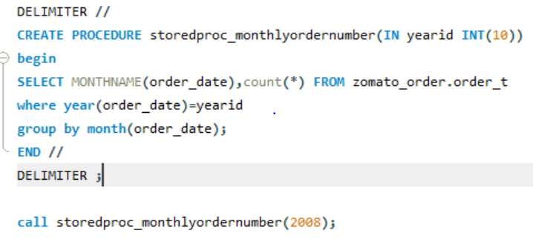
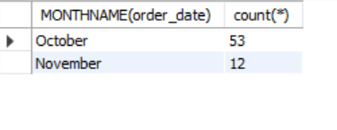
QUERY - 3 (COUNT OF MONTHLY ORDERS PLACED IN AN YEAR) - USING STORED PROCEDURE
QUERY
OUTPUT

Slide 15
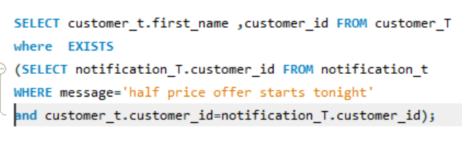
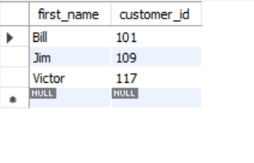
QUERY – 4 (PEOPLE WHO HAVE RECEICED A PATICULAR MESSAGE VIA NOTIFICATION) - USING EXISTS
QUERY
OUTPUT

Slide 16
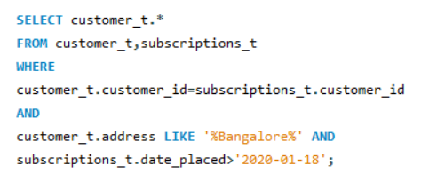
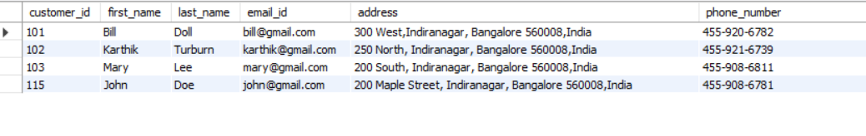
QUERY – 5 (SUBSCRIPTIONS taken AFTER PARTICULAR DATE in a city) – USING equi join
QUERY
OUTPUT

Slide 17
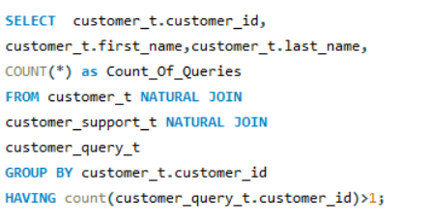
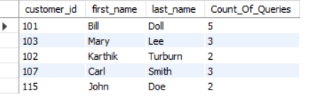
QUERY – 6 (COUNT OF customer queries>1)
- USING NATURAL JOIN
QUERY
OUTPUT

Slide 18
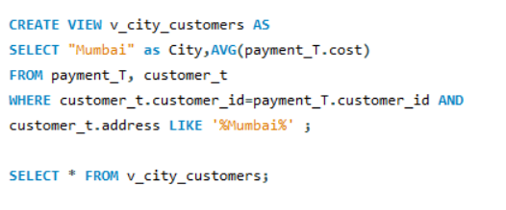

QUERY – 7 (FIND AVERAGE cost FOR ORDERS IN A city avg payment) – USING VIEW
QUERY
OUTPUT

Slide 19
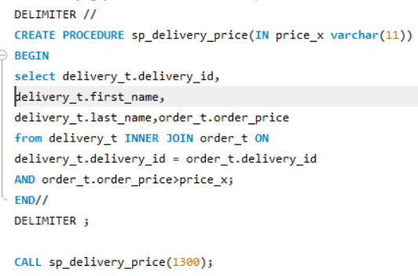
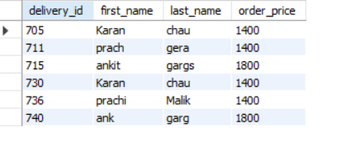
QUERY – 8 (details of delivery agent who Delivered orders above a price) –STORED PROCEDURE
QUERY
OUTPUT

Slide 20
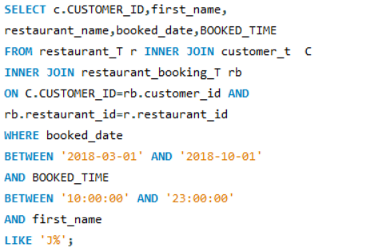

QUERY – 9 (LISTING ALL CUSTOMERS WHO BOOKED TABLES) – USING INNER JOIN
QUERY
OUTPUT

Slide 21
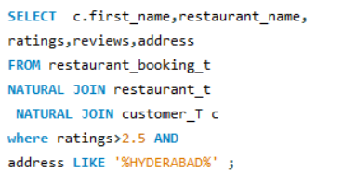
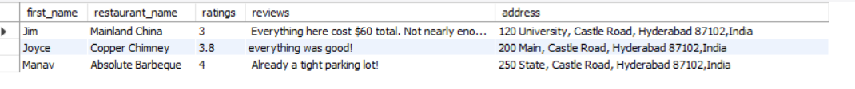
QUERY – 10
(listing customers who visited restaurant with rating >2.5 in a city) – USING NATURAL JOIN
QUERY
OUTPUT

Slide 22
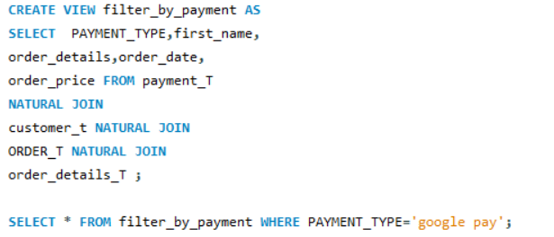
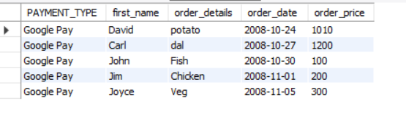
QUERY – 11
(DETAILS OF CUSTOMERS WHO PLACED ORDERS USING DIFFERENT PAYMENT TYPES) – USING VIEWT TYPES
QUERY
OUTPUT

Slide 23
THANK YOU!!

